Slide 1

Accelerating Machine Learning for Complex RPG Games: A Case Study with PPO and Pokémon Red
Caio Valente (github.com/valentecaio)
20th June 2024

Slide 2
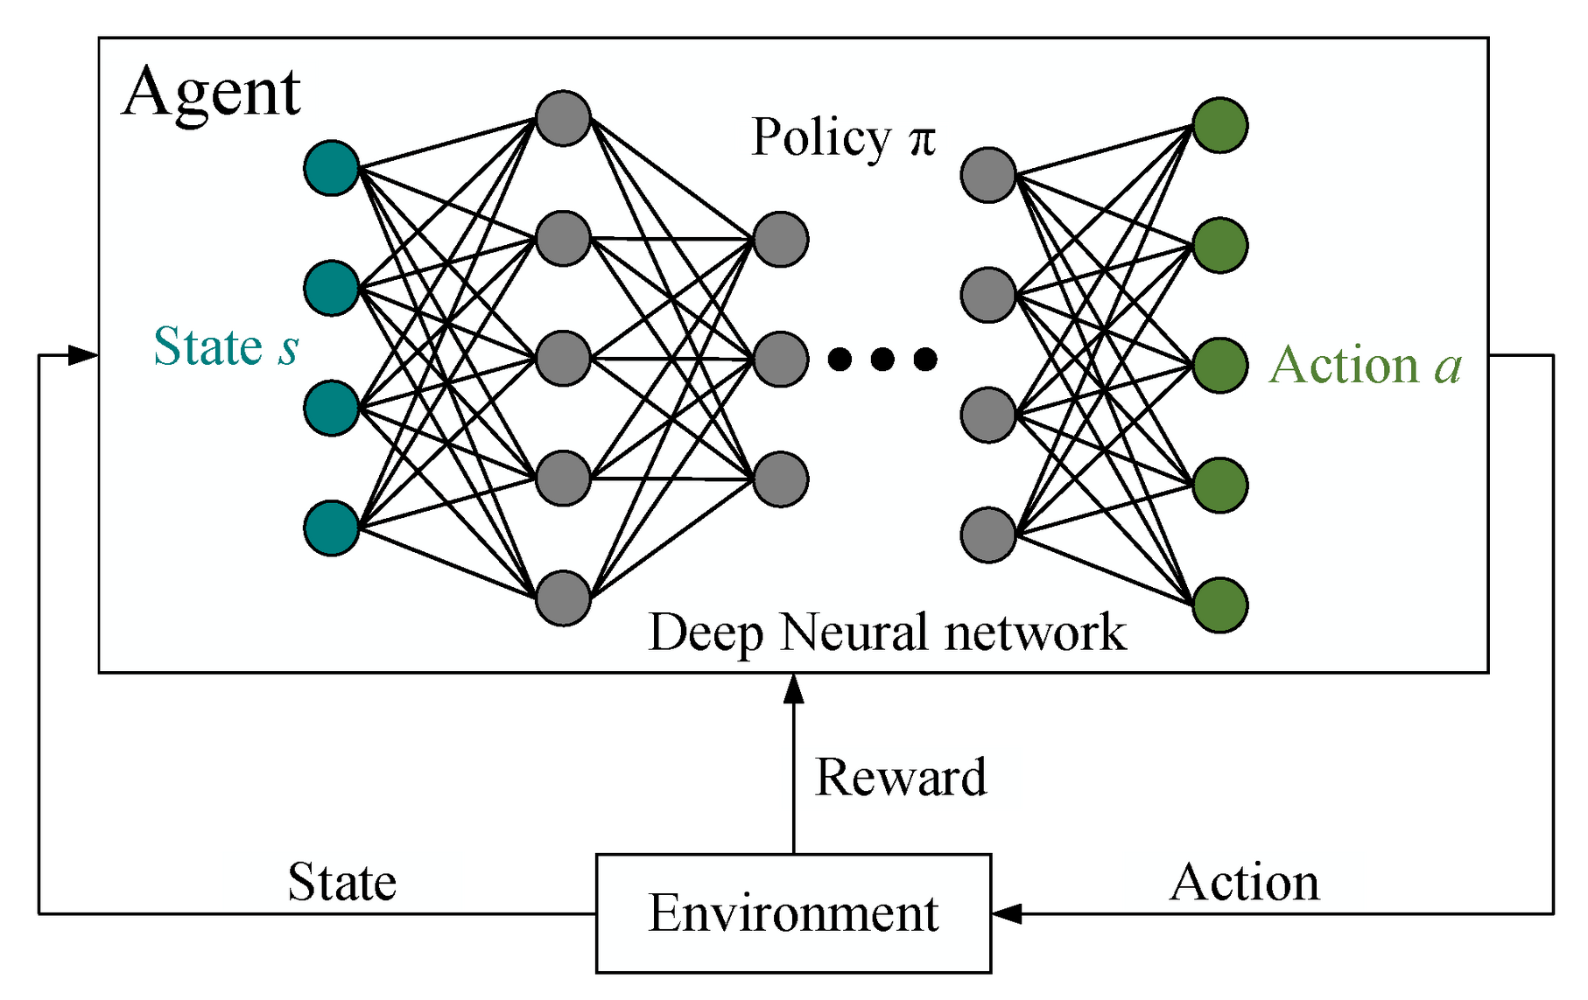
Introduction
Deep Reinforcement
Learning
Pokémon Red
Environment bottleneck

Slide 3
Related Work
ALE - Arcade Learning Environment (2013)
DQN Algorithm (2015)
PPO Algorithm (2017)
PyBoy emulator
Peter Whidden’s research (2023)

Slide 4
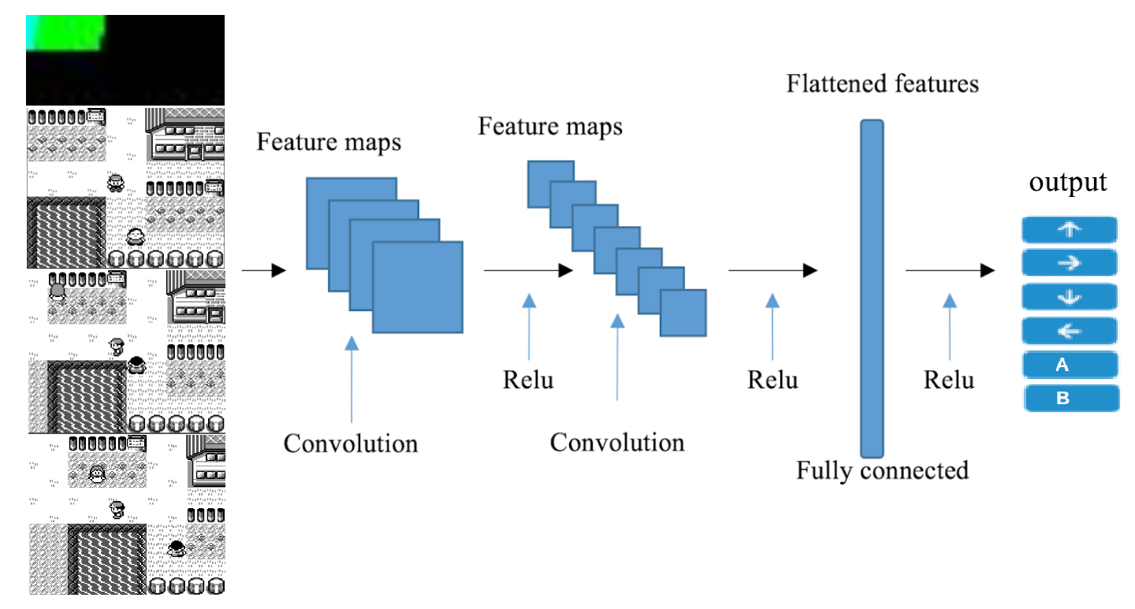

Slide 5
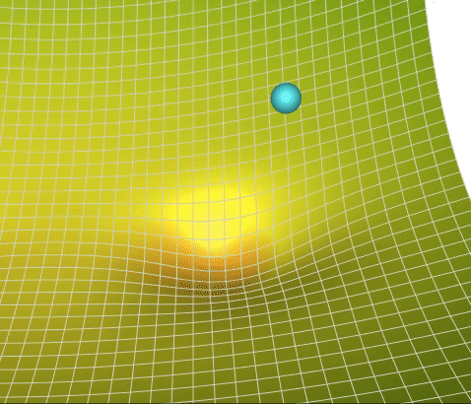
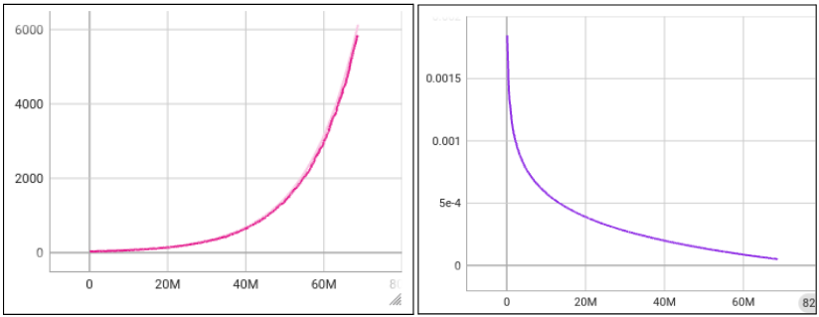
Proposed Work
Find models that converge faster
Hyperparameters:
Batch size (small, big, exp)
Learning rate (log)
Entropy coefficient
AdamW - Weight decay

Slide 6
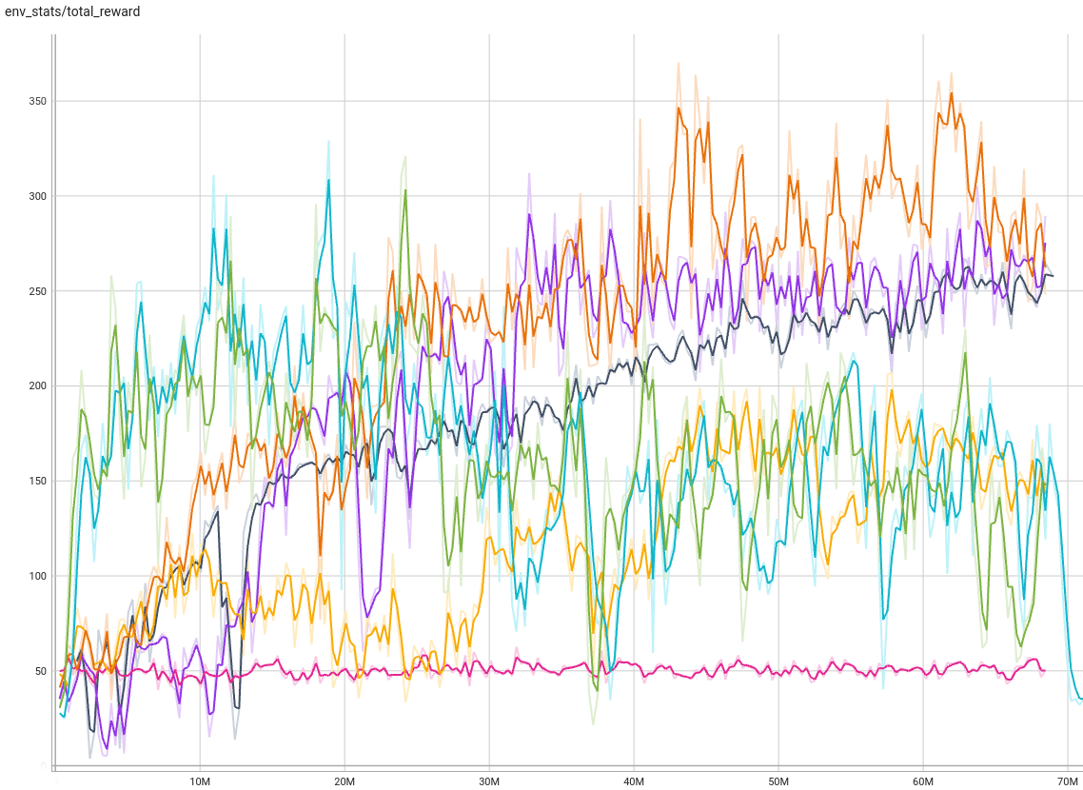
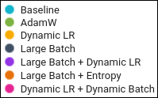
Experiments and Results
Six model variations
233 Episodes or 68M steps
Rewards:
Map exploration
Healing
Total Pokémon level
Gym
Large batches: satisfactory

Slide 7
Conclusions and Future Work
Longer batches are good candidates
Dynamic parameters need better tuning
Hardware limitations
Longer episodes
Longer training
Different CNN architectures

Slide 8
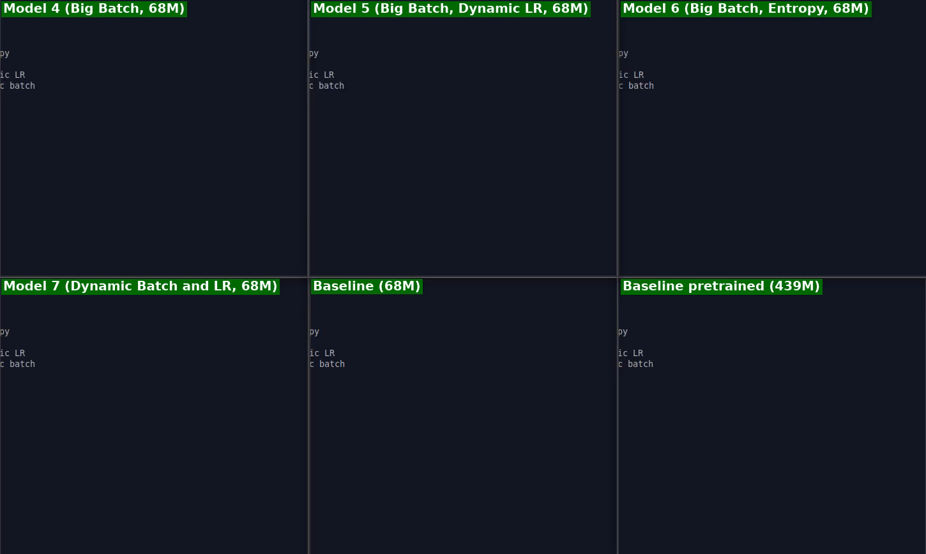
Demo

Slide 9
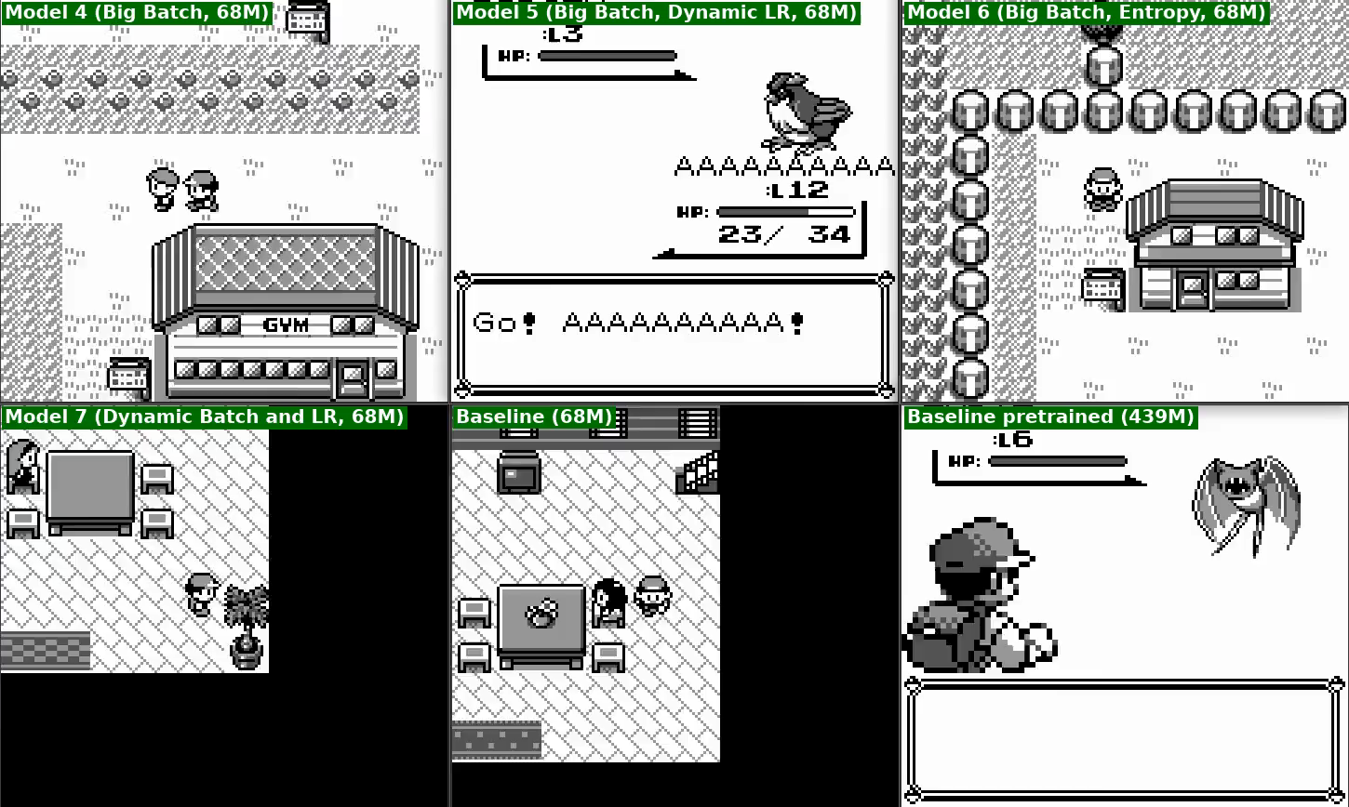

Slide 10
https://drive.google.com/drive/folders/1SSemuoGkHycw_55yUy3p8GzlBgToltQ-

